Slide 1
Shrubs

Slide 2
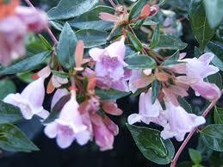
Pink Abelia

Slide 3
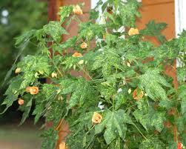
Flowering Maple

Slide 4
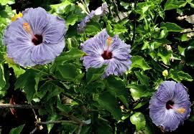
Blue Hibiscus

Slide 5
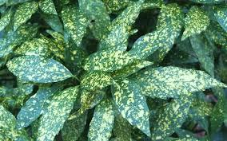
Gold Dust Plant

Slide 6
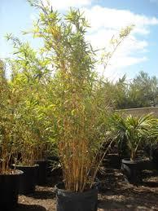
Golden Goddess Bamboo

Slide 7
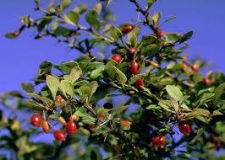
Japanese Barberry

Slide 8
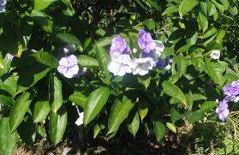
Yesterday-Today-Tomorrow

Slide 9
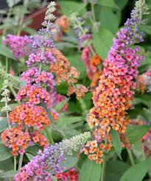
Butterfly Bush

Slide 10
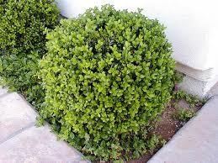
Japanese Boxwood

Slide 11
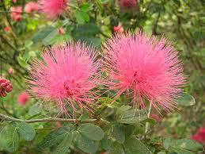
Pink Powder Puff

Slide 12
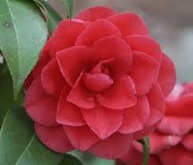
Japanese Camellia

Slide 13
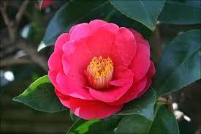
Camellia

Slide 14
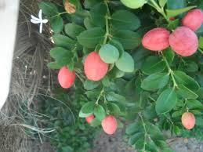
Natal Plum

Slide 15
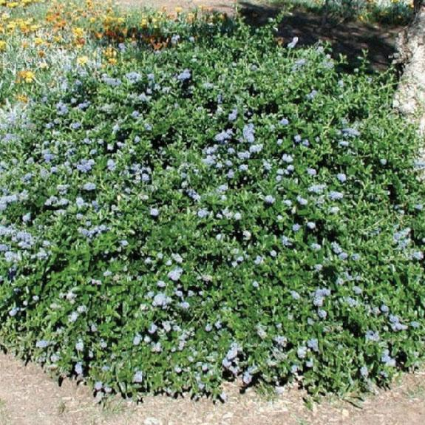
Carmel Creeper

Slide 16
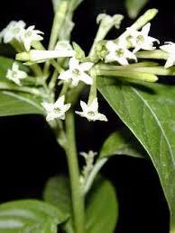
Night Jessamine

Slide 17
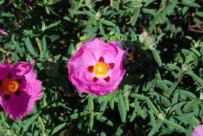
Orchid Rockrose

Slide 18
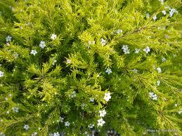
Sunset Gold Breath of Heaven

Slide 19
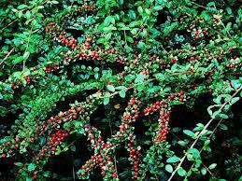
Rock Cotoneaster

Slide 20
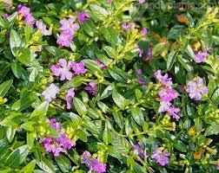
False Heather

Slide 21
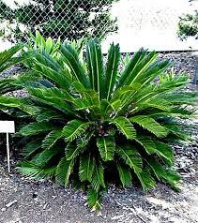
Sago Palm

Slide 22
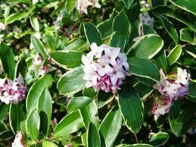
Winter Daphne

Slide 23
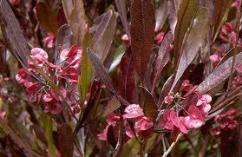
Purple Hop Bush

Slide 24
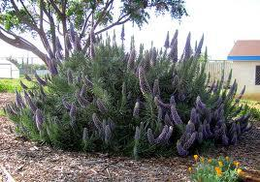
Pride of Madeira

Slide 25
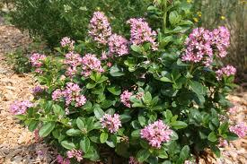
Pink Escallonia

Slide 26
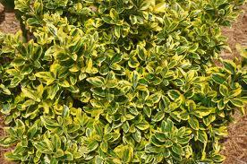
Golden Euonymus

Slide 27
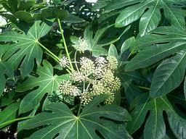
Japanese Aralia

Slide 28
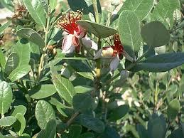
Pineapple Guava

Slide 29
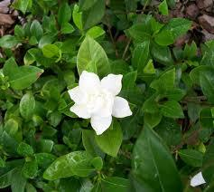
Miniature Gardenia

Slide 30
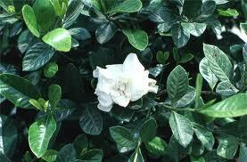
Everblooming Gardenia

Slide 31
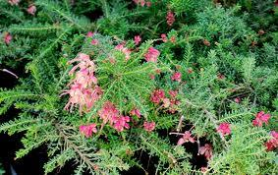
Noell’s Grevillea

Slide 32
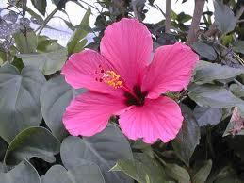
Chinese Hibiscus

Slide 33
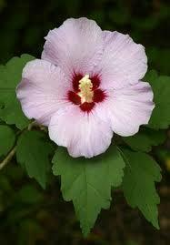
Rose of Sharon

Slide 34
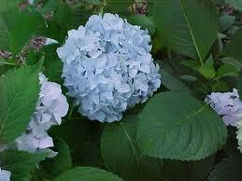
Bigleaf Hydrangea

Slide 35
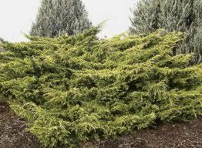
Gold Coast Juniper

Slide 36
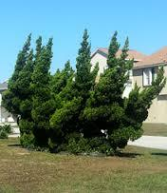
Hollywood Juniper

Slide 37
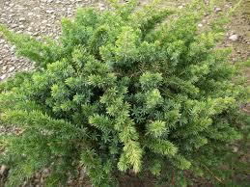
Shore Juniper

Slide 38
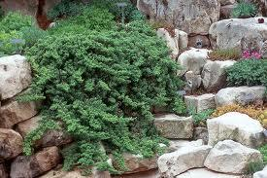
Dwarf Japanese Garden Juniper

Slide 39
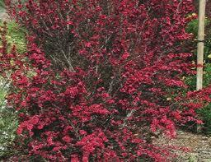
New Zealand Tea Tree

Slide 40
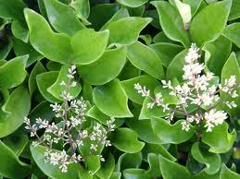
Waxleaf Privet

Slide 41
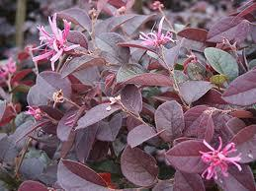
Chinese Fringe Flower

Slide 42
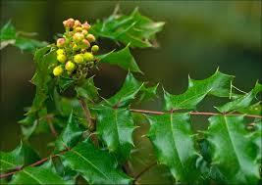
Oregon Grape

Slide 43
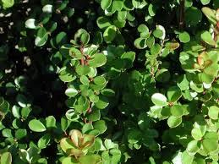
African Boxwood

Slide 44
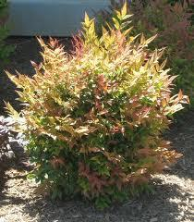
Gulf Stream Heavenly Bamboo

Slide 45
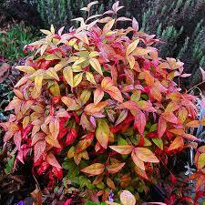
Dwarf Heavenly Bamboo

Slide 46
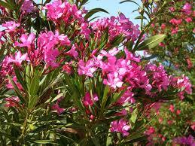
Oleander

Slide 47
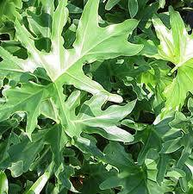
Philodendron

Slide 48
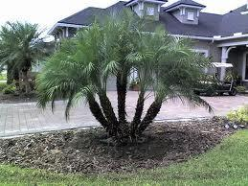
Pygmy Date Palm

Slide 49
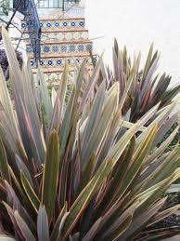
New Zealand Flax

Slide 50
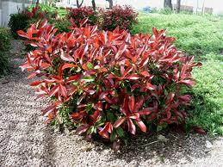
Fraser's Photinia

Slide 51
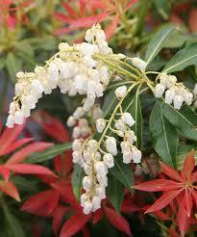
Lily of the Valley

Slide 52

Mugho Pine

Slide 53

Black Stem Pittosporum

Slide 54

Dwarf Wheelers Dwarf Mock Orange

Slide 55

Cape Plumbago

Slide 56

Strawberry Guava

Slide 57

Graber Firethorn

Slide 58

Flowering Indian Hawthorne

Slide 59

Southern Indica Azalea

Slide 60

Rhododendron

Slide 61

Rose

Slide 62

Paraguay Nightshade

Slide 63

Spirea

Slide 64

Bird of Paradise

Slide 65

Common Lilac

Slide 66

Brush Cherry

Slide 67

Cape Honeysuckle

Slide 68

Ternstroemia

Slide 69

Bush Germander

Slide 70

Dwarf Golden Arborvitae

Slide 71

Princess Flower

Slide 72

Common Snowball

Slide 73

Spring Bouquet Viburnum

Slide 74

Coast Rosemary

Slide 75

Shiny Xylosma

Slide 76

Spanish Dagger

